Slide 1
Chemicals in Cosmetics
DAB-16
Ahmed Ghasan
Noor AlHayki
Maryam Yusuf
Amna Hussain

Slide 2
Introduction
Cosmetics in daily life
Hidden chemical risks
Data-driven investigation

Slide 3
Problem Statement
Between 2009 and 2020, 86.3% of monitored cosmetic products in California contained harmful chemicals. This finding reveals a persistent and unaddressed public health risk, as the vast majority of these dangerous products remain actively sold despite their documented toxicity.

Slide 4
Analytic Questions
1
Top 5 product types with harmful chemicals
2
Top 5 brands producing harmful products
3
Too Faced product with most harmful chemicals
4
Active vs. discontinued harmful products

Slide 5
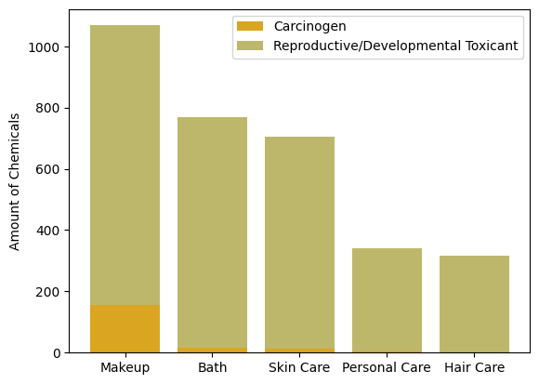
Top harmful product types

Slide 6
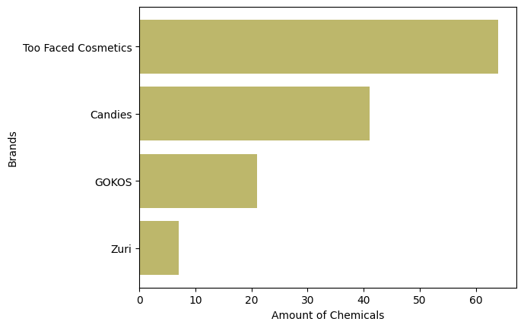
Brands with the most harmful products

Slide 7
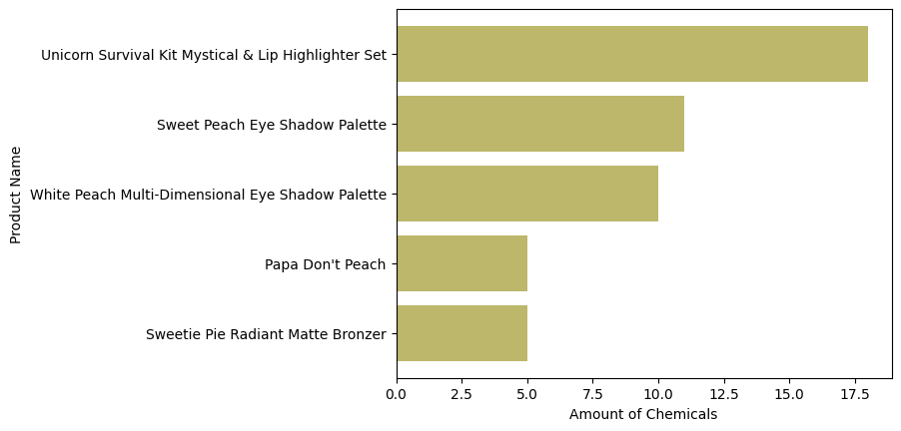
The Too Faced product containing the highest number of harmful chemicals

Slide 8
Status of harmful products: active or discontinued
Product Name | Status
Too Faced Unicorn Survival Kit Mystical & Lip Highlighter Set | Discontinued
Too Faced Sweet Peach Eye Shadow Palette | Active
Too Faced White Peach Multi-Dimensional Eye Shadow Palette | Active
Too Faced Papa Don't Peach | Active
Too Faced Sweetie Pie Radiant Matte Bronzer | Active

Slide 9
Conclusion
1
2
Makeup = most carcinogenic category
Too Faced = top harmful brand
3
Some discontinued; others still active

Slide 10
Recommendations
Replace harmful chemicals
Remove toxic products from market
Ensure CSR & safety before launch

Slide 11
Limitation
Some companies may not fully report product ingredients
Data only includes products sold in California

Slide 12
THANK YOU!
Any questions?

